Slide 1
HEART DISEASE PREDICTION MODEL
Submitted in the partial fulfillment for the award of the degree of
BACHELOR OF ENGINEERING
IN
CSE-AIML
Submitted by:
21BCS3719- KHUSHBU
21BCS3895- CEERAT RANDHAWA
21BCS8229- PRABHNOOR
21BCS8276- PRABHANSH
21BCS6075- DHAIRYA GUPTA
Under the Supervision of:
Ms. MALTI RANI
Department of AIT-CSE
DISCOVER . LEARN . EMPOWER

Slide 2
Outline
Introduction to Project
Problem Formulation
Objectives of the work
Methodology used
Results and Outputs
Conclusion
Future Scope
References

Slide 3
Introduction to Project
Heart disease is a leading cause of mortality worldwide, responsible for millions of deaths each year. Early detection and intervention are critical for improving patient outcomes and reducing the burden of this disease.
In recent years, machine learning techniques have emerged as a promising tool for predicting heart disease risk and supporting clinical decision-making.

Slide 4
This project aims to develop and evaluate machine learning-based models for predicting heart disease risk. Using a diverse dataset of patient records, the models will be trained to identify patterns and risk factors associated with heart disease, such as age, gender, blood pressure, and cholesterol levels.
The models will then be tested and validated using various performance metrics, such as accuracy, sensitivity, and specificity, to assess their effectiveness in predicting heart disease risk.

Slide 5
Problem Formulation
Heart disease is one of the leading causes of death worldwide, and early detection is crucial for successful treatment and management of the disease. Traditional methods of heart disease prediction, such as blood tests and physical examinations, are not always accurate or reliable.
Machine learning-based heart disease prediction models can analyze large amounts of data and learn patterns that are difficult for humans to detect. These models can integrate various data sources, including medical history, lifestyle factors, and genetic information, to provide accurate and personalized risk assessments.

Slide 6
Using a machine learning-based approach, healthcare providers can identify patients at high risk of developing heart disease, and provide them with appropriate interventions to prevent or delay the onset of the disease. This approach can lead to earlier detection, improved treatment outcomes, and reduced healthcare costs.

Slide 7
Objectives of the Work
The primary objectives of this model are:
Early Detection
Accurate Prediction
Risk Assesment
Personalised Medicine
Improved Efficiency

Slide 8
Methodology Used
The methodology for developing a machine learning-based heart disease prediction model typically involves the following steps:
Data Collection
Data pre-processing
Feature Selection
Model Selection
Deployment
Data Collection & Preprocessing
Feature Selection
Model Evaluation
Random Forest Model
Model Deployment

Slide 9
Results and Outputs
Numerous models were used to create the prediction model. Some of them are mentioned below:
Support Vector Machines (SVM)
K-Nearest Neighbours (KNN)
Gradient Boosting
Decision Trees
Random Forest

Slide 10
Support Vector Machines (SVM)
Support Vector Machines (SVM) is a machine learning algorithm used for heart disease prediction.
SVM finds an optimal hyperplane to separate patients with and without heart disease by maximizing the margin between classes.
SVM is flexible, allowing the use of different kernel functions to capture complex patterns and nonlinear relationships in the data.
SVM is robust to outliers, promotes feature selection, and provides good generalization to unseen patient data.

Slide 11
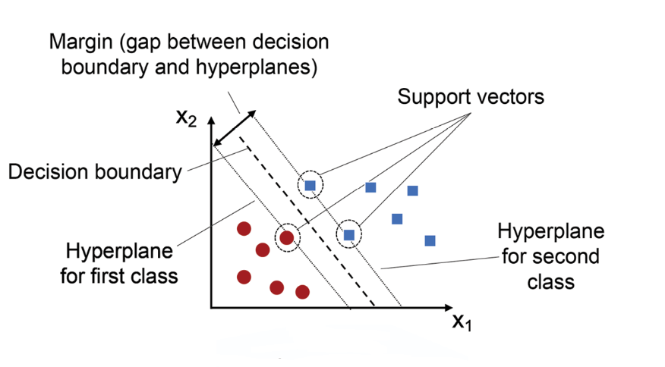
Benefits of SVM
Flexibility
Robustness to outliers
Feature Selection
Generalization
In our Implementation of
SVM, the model achieved an
Accuracy of 80.97%

Slide 12
K-Nearest Neighbours (KNN)
K-Nearest Neighbors (KNN) is a simple and intuitive machine learning algorithm used for heart disease prediction.
KNN classifies a new patient based on the classes of its nearest neighbors in the feature space.
KNN is flexible, capable of handling both linear and nonlinear relationships between features and heart disease status.
KNN provides interpretable results and can quickly adapt to new data, making it suitable for dynamic environments.

Slide 13
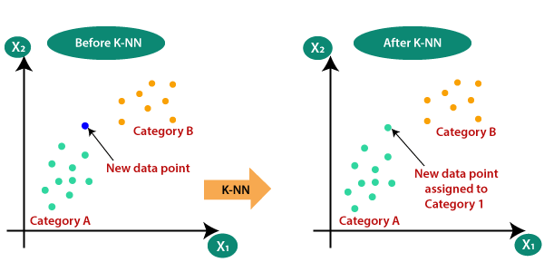
Adavntages of KNN
Simplicity
Flexibility
Interpretable Results
Adaptability
In our Implementation of
KNN, the model achieved an
Accuracy of 73.17%

Slide 14
Gradient Boosting
Gradient Boosting is an ensemble machine learning algorithm used for heart disease prediction.
It combines multiple weak models, typically decision trees, to create a strong predictive model.
Gradient Boosting achieves high accuracy by iteratively improving the model and capturing complex relationships between features and heart disease.
It provides insights into feature importance, robustness to noise and outliers, and generalization to unseen data.

Slide 15
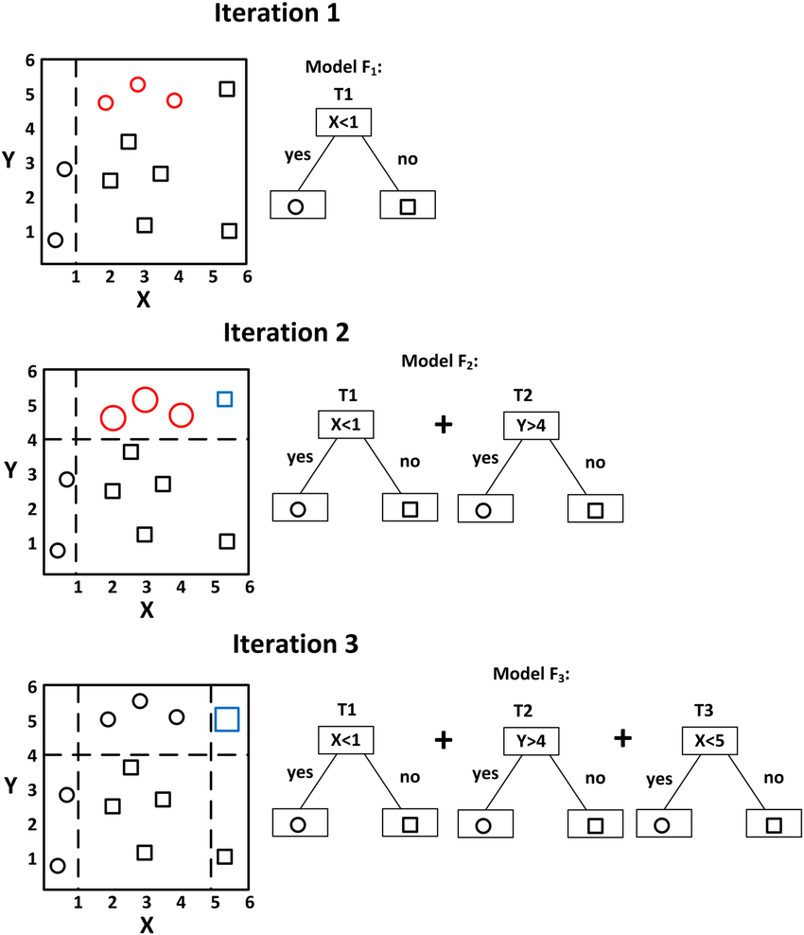
Advantages of Gradient Boosting
High Accuracy
Feature Importance
Robustness
Generalization
In our Implementation of
the model, it achieved an
Accuracy of 89.26%

Slide 16
Decision Trees
Decision Trees are a popular and interpretable machine learning algorithm for heart disease prediction.
They create a tree-like model based on input features to make predictions about the presence or absence of heart disease.
Decision Trees offer interpretability, feature importance analysis, and the ability to capture nonlinear relationships.
However, they can be prone to overfitting and instability, which can be addressed through techniques like pruning and ensemble methods.

Slide 17
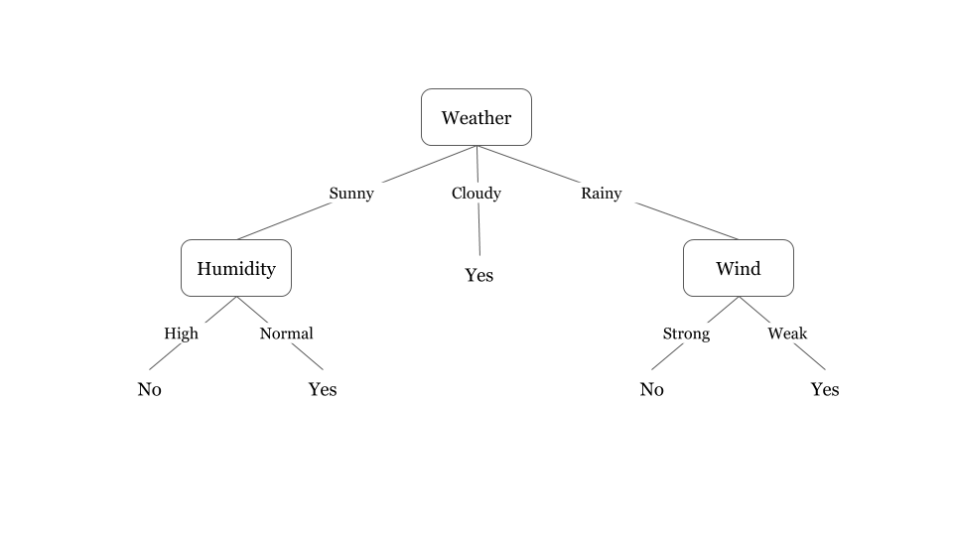
Advantages of Gradient Boosting
Interpretable Model
Feature Importance
Nonlinear Relationships
Robustness

Slide 18
Random Forest
Random Forest is an ensemble machine learning algorithm used for heart disease prediction.
It combines multiple decision trees to create a robust and accurate predictive model.
Random Forest offers high accuracy, robustness to noise, feature importance analysis, and generalization capabilities.
It leverages the collective decision-making of multiple trees, resulting in improved prediction performance and a reliable predictive model.

Slide 19
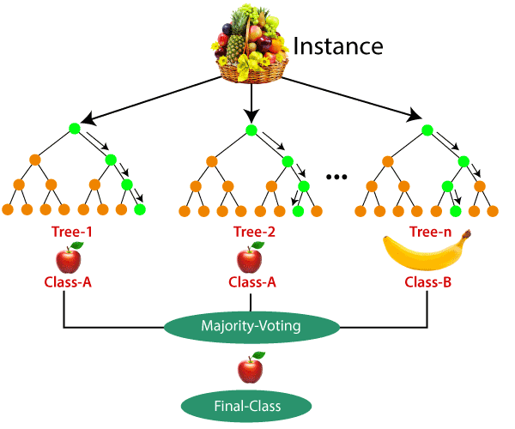
Advantages of Random Forest
High Accuracy
Robustness to Noise
Feature Importance
Generalization
In our Implementation of the model,
it achieved an accuracy of 98.53%

Slide 20
Tabular Comparison of Various Algorithms
Algorithm | Accuracy
Random Forest Classifier | 98.53%
Support Vector Machines | 80.97%
KNN | 73.17%
Gradient Boosting Classifier | 89.26%

Slide 21
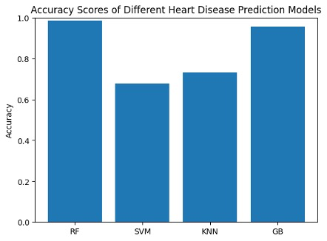

Slide 22
Conclusion
In conclusion, developing and evaluating machine learning-based heart disease prediction models have shown great potential in improving the accuracy and efficiency of cardiac risk assessment.
However, further research and validation are necessary to ensure that these models are reliable, transparent, and ethical in their implementation. With continued investment and collaboration, machine learning-based heart disease prediction models have the potential to revolutionize the field of cardiology and ultimately improve patient outcomes.

Slide 23
Future Scope
There is significant future scope for machine learning-based heart disease prediction models. Here are some potential areas of development
Personalization
Integration with electronic health records (EHRs)
Real-time monitoring

Slide 24
References
[1] Development of a machine learning-based prediction model for heart disease using cardiac biomarkers and clinical data by A. B. Zaman, T. L. Asselbergs, and R. C. Kraaijenhagen, (2020).
[2] A deep learning-based framework for predicting heart disease by M. A. Hoque and S. T. Ahmed, (2020)
[3] Heart disease prediction using machine learning: A review by A. S. Alazab, A. S. Almgren, and A. Al-Fuqaha, (2021).
[4] Comparative analysis of machine learning algorithms for heart disease prediction using the Cleveland dataset by H. M. Alhazmi and A. I. Alharbi, (2021)
[5] Machine learning-based prediction of coronary artery disease using clinical data by H. Kim, Y. K. Kim, and J. Y. Hwang, (2021)

Slide 25
[6] An ensemble of machine learning algorithms for predicting heart disease by F. Li, Y. Li, and Y. Li, (2022)
[7] Development of a machine learning-based prediction model for heart disease using laboratory and clinical data by J. L. Clevenger, M. C. Grant, and S. R. Thomas, (2020)

Slide 26

Thank you

